Slide 1
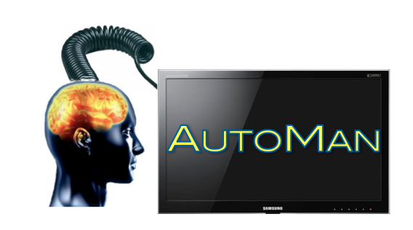
Programming with People: Integrating Human-Based & Digital Computation
Emery Berger, Dan Barowy, Charlie Curtsinger, Andrew McGregor University of Massachusetts, Amherst

Slide 2
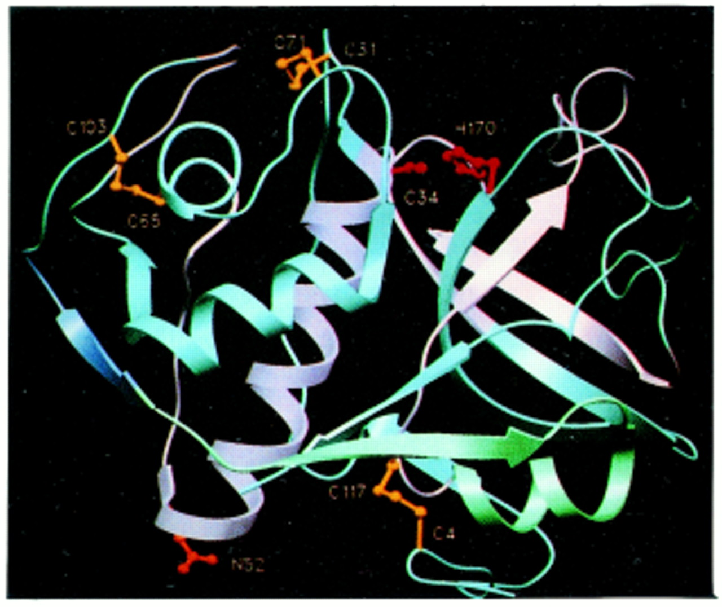
Notes:
Digital computation – success story. Lots of great stuff like decoding the human genome

Slide 3
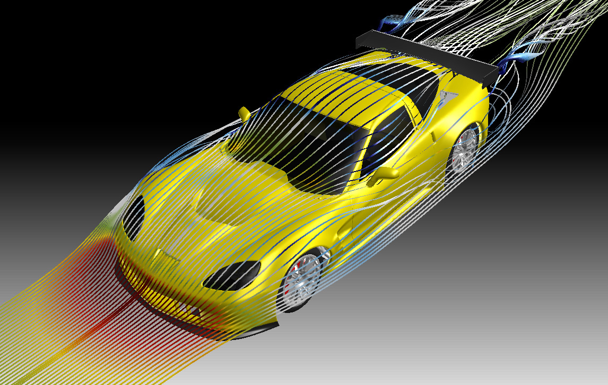
Notes:
Computers great at some things – aerodynamic simulation

Slide 4
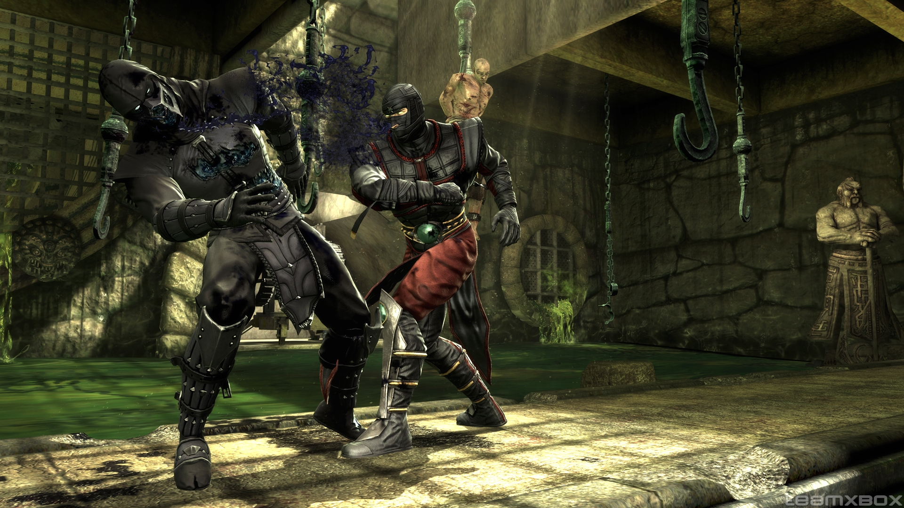
Notes:
3D simulations

Slide 5
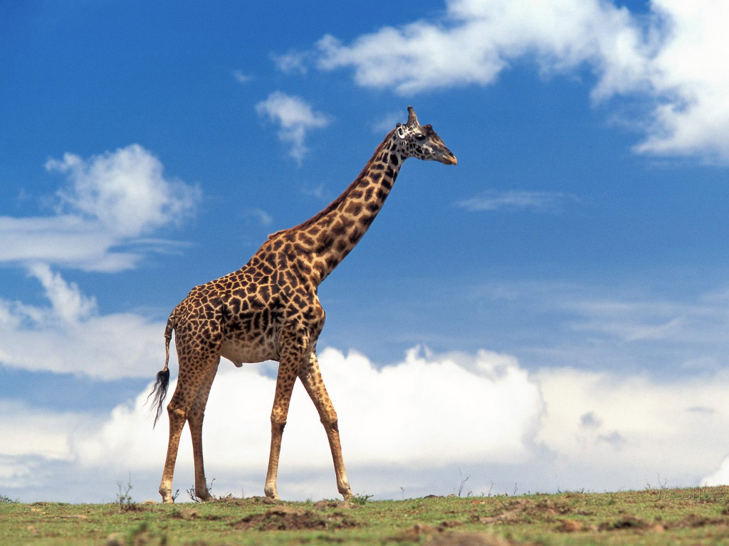
Notes:
Computers not so good at other tasks

Slide 6
“is this a giraffe?”
Notes:
Computers not so good at other tasks

Slide 7
isGiraffe(image)
Notes:
Can’t just call this function. What’s the answer?

Slide 8
isGiraffe( )

Slide 9
isGiraffe( )

Slide 10
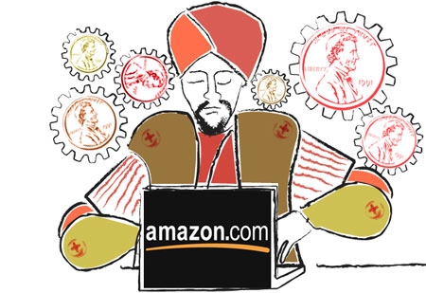
isGiraffe( )

Slide 11
http://mturk.com

Slide 12
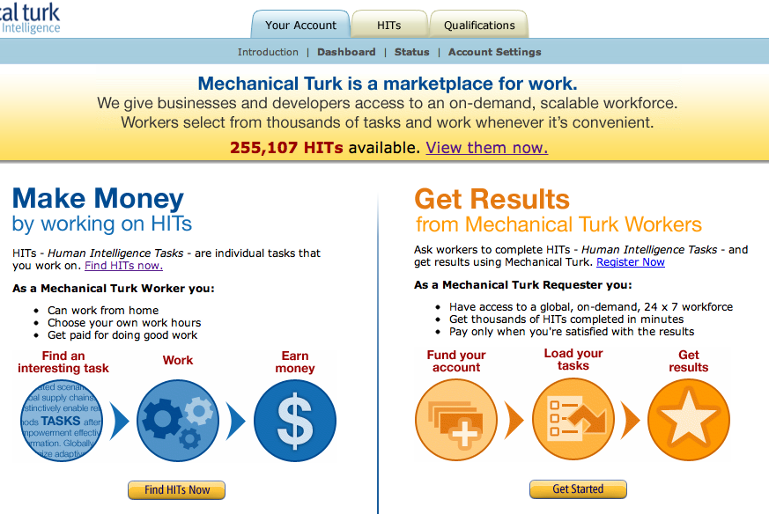
http://mturk.com

Slide 13
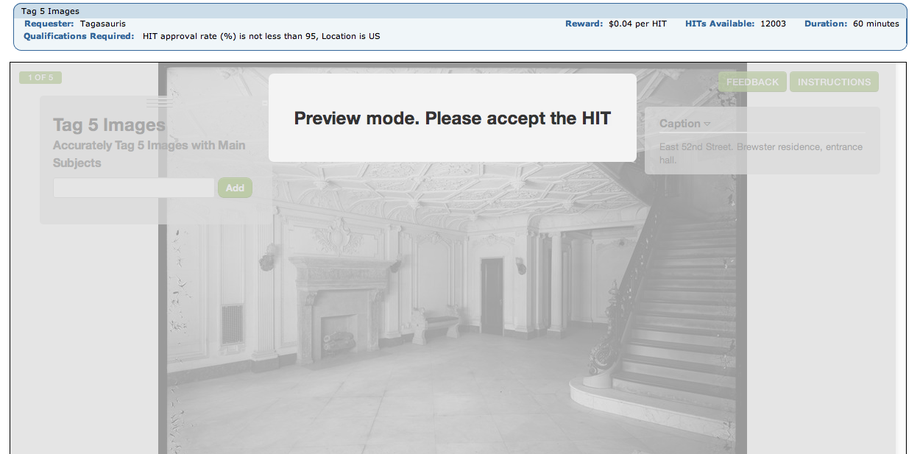

Slide 14
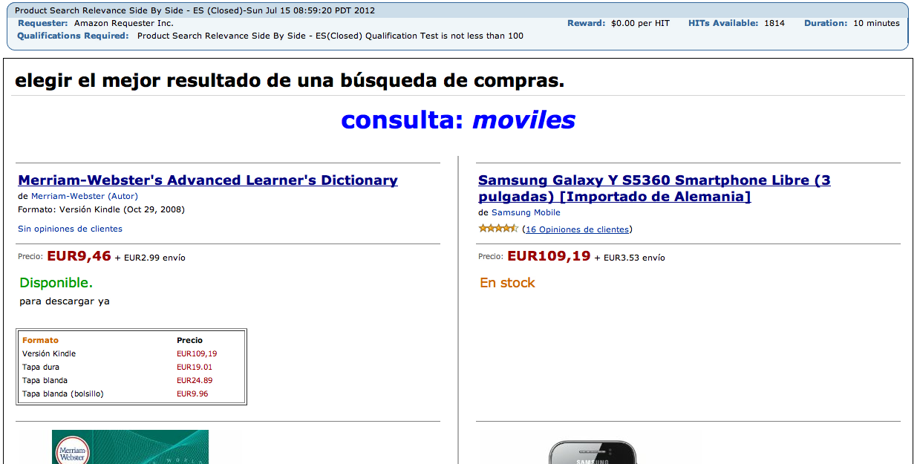

Slide 15
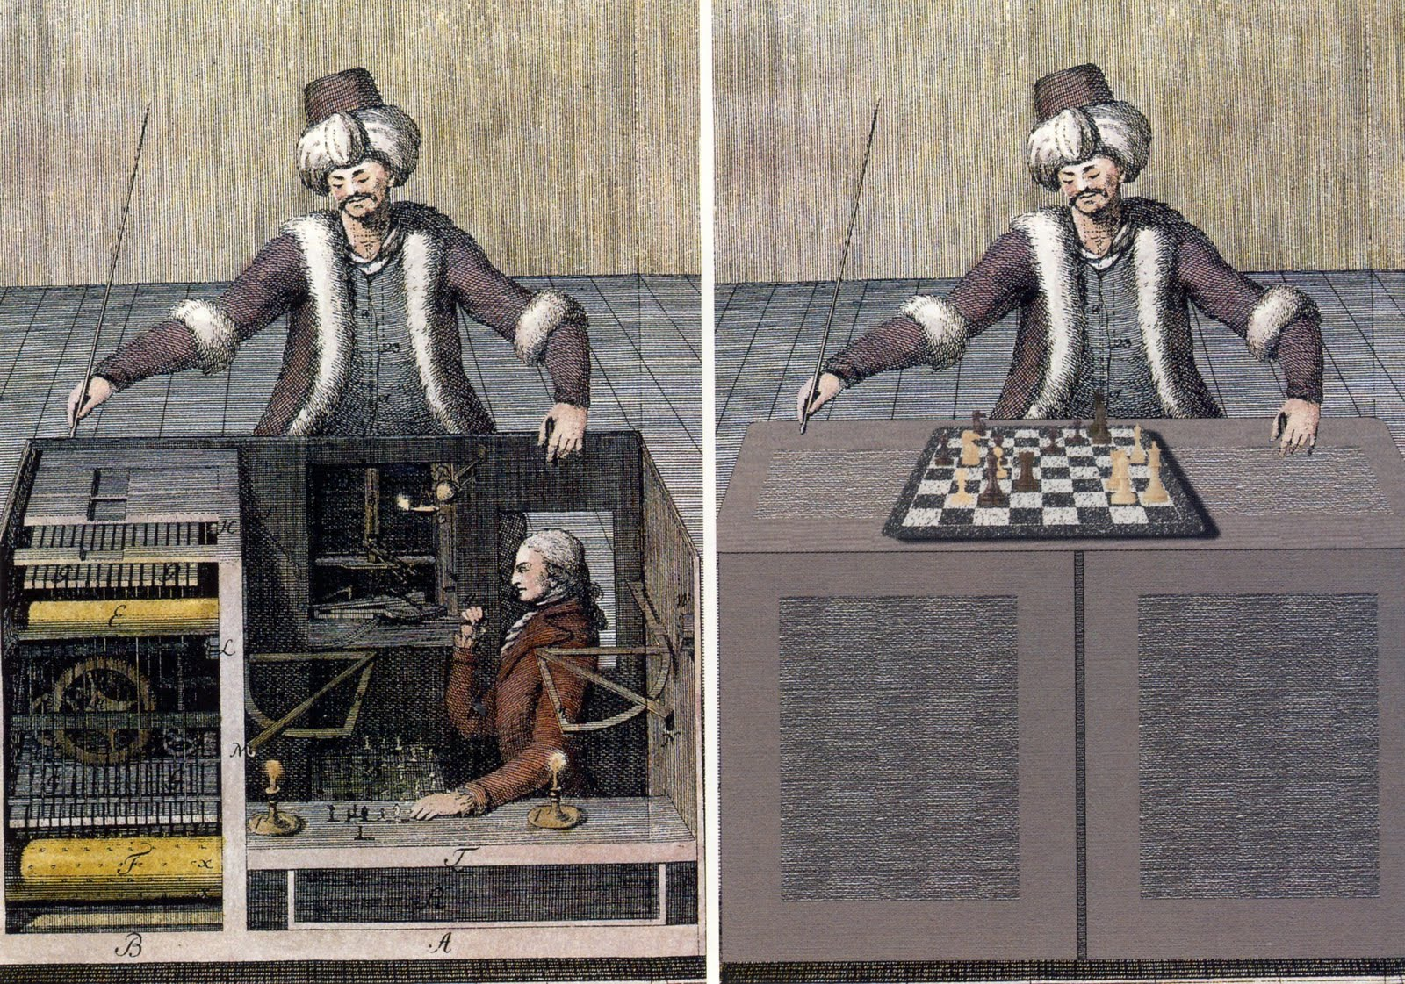

Slide 17
isGiraffe( )
True
Notes:
Great – but lots of challenges.

Slide 18
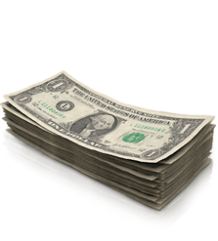
isGiraffe( )
True
Notes:
You have to pay workers. How much should you pay?

Slide 19
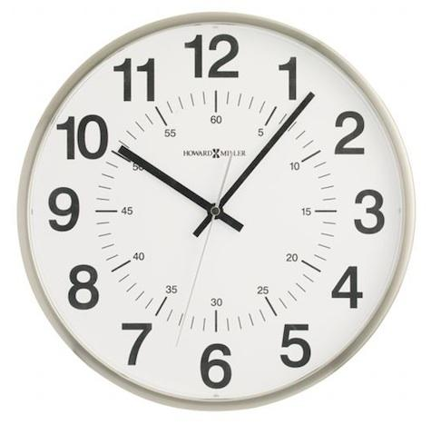
isGiraffe( )
True
Notes:
How long should the task take?

Slide 20
isGiraffe( )
False
Notes:
And most importantly, how do we know the answer is right? What if they answer incorrectly?

Slide 21

isGiraffe( )
False
Notes:
We need *confidence* in our results. People might just guess!

Slide 22
False
Notes:
Why would they get this wrong?

Slide 23
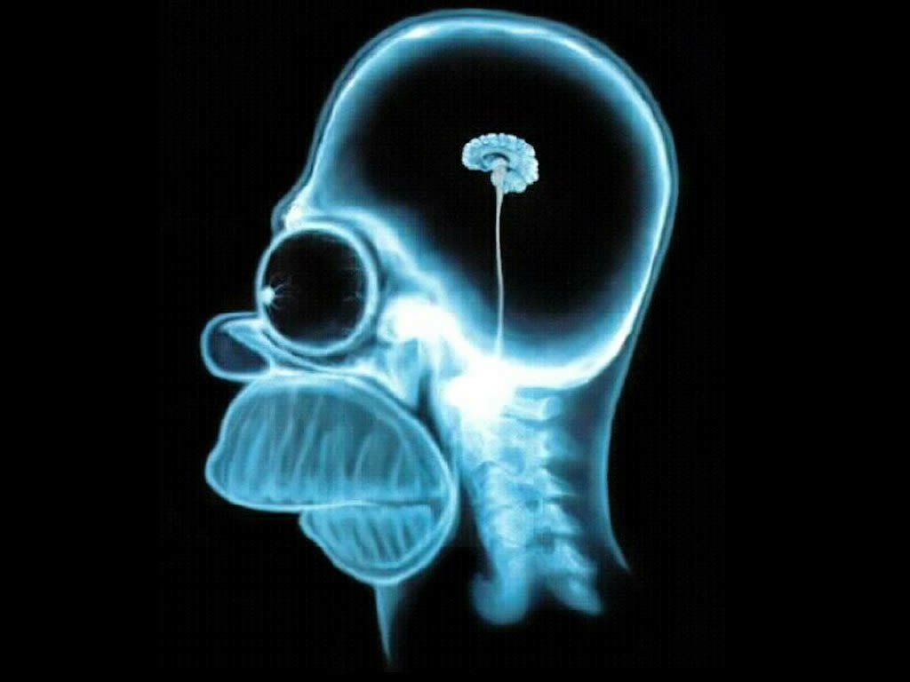
False
Notes:
Could be stupid or lazy

Slide 24

False
Notes:
Could be bots.

Slide 25
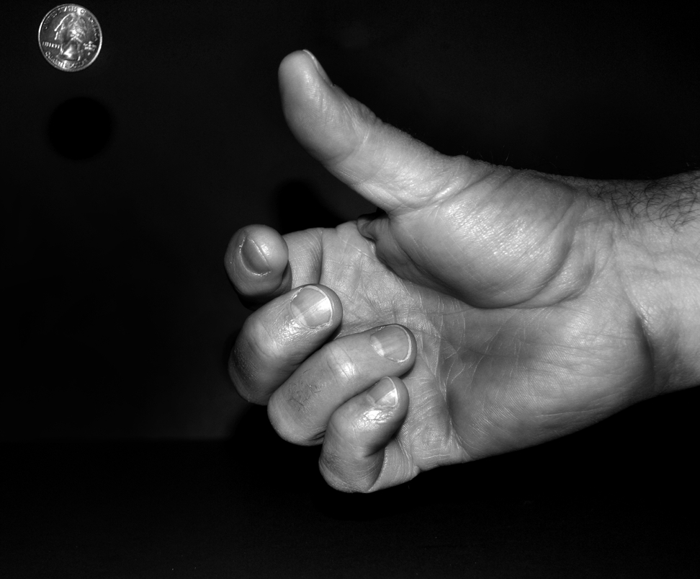
False
Notes:
Either way, they could just be guessing (definitely if they are bots – these already exist).

Slide 26
isGiraffe( )
?
Notes:
What do we do about this? Idea: VOTE.

Slide 27
isGiraffe( )
Notes:
If both guys agree, then we are happy. Right?

Slide 28
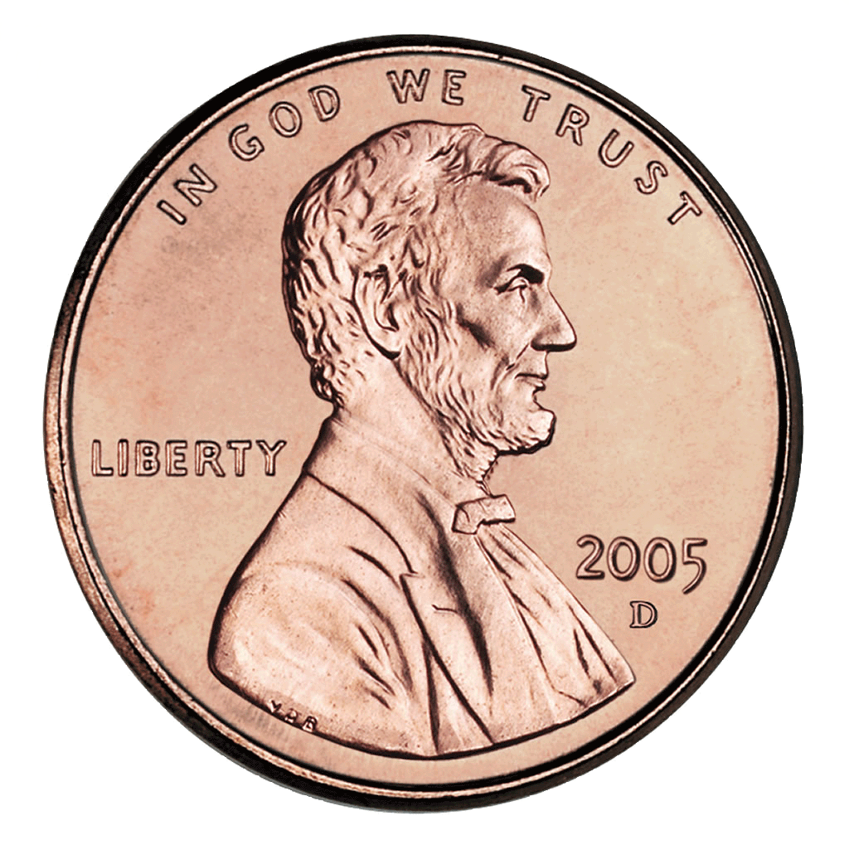

isGiraffe( )
Notes:
Nope. Consider coin flips.

Slide 29
isGiraffe( )
P(agreement) = ½

Slide 30
isGiraffe( )
P(agreement) = 1/32 (< 5%)

Slide 31
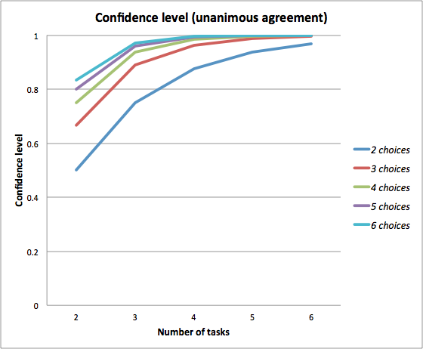
Notes:
If you have N workers that agree (x-axis), and you are asking each of them questions with 2 choices, 3 choices, etc., you can get higher and higher confidence as the number of workers (tasks) and the number of answers goes up.

Slide 32
isGiraffe( )
Notes:
We need *confidence* in our results.
AutoMan automatically handles all of these problems.

Slide 33

isGiraffe( )
( )
Notes:
We need *confidence* in our results.
AutoMan automatically handles all of these problems.

Slide 34
isGiraffe( )
( )
AutoMan programmer-specified
Total $ for computation
Notes:
We need *confidence* in our results.
AutoMan automatically handles all of these problems.

Slide 35
isGiraffe( )
( )
AutoMan programmer-specified
Total $ for computation
95% (p < 0.05)
Confidence level (per function)
Notes:
We need *confidence* in our results.
AutoMan automatically handles all of these problems.

Slide 36
isGiraffe( )
US minimum wage,
Adaptive doubling
Notes:
We need *confidence* in our results.
AutoMan automatically handles all of these problems.

Slide 37
isGiraffe( )
US minimum wage,
Adaptive doubling
30s, $0.06 ($7.25 / 120)
Notes:
We need *confidence* in our results.
AutoMan automatically handles all of these problems.

Slide 38
isGiraffe( )
US minimum wage,
Adaptive doubling
prevents gaming (see paper)
30s, $0.06 ($7.25 / 120)
60s, $0.12
Notes:
We need *confidence* in our results.
AutoMan automatically handles all of these problems.

Slide 39
isGiraffe( )
True
95% confidence
Notes:
We need *confidence* in our results.
AutoMan automatically handles all of these problems.

Slide 40
Notes:
Note that you don’t necessarily need a majority! As the number of tasks increases – and as the number of choices (answers) increases – you can get 95% confidence with a smaller and smaller fraction.

Slide 41
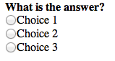
“radio button”

Slide 42
“radio button”
n choices (3)

Slide 43
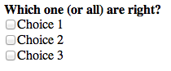
“radio button”
n choices (3)
“checkboxes”

Slide 44
“radio button”
n choices (3)
“checkboxes”
2^n choices (8)

Slide 45
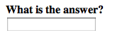
“radio button”
n choices (3)
“checkboxes”
2^n choices (8)
“text”

Slide 46
“radio button”
n choices (3)
“checkboxes”
2^n choices (8)
“text”
computed/provided

Slide 47
Notes:
Let’s talk about our model of a worker. He LOOKS so SAD! What makes him happy? What motivates him?

Slide 48

Notes:
Money. That’s why he’s there. He likes money.

Slide 49
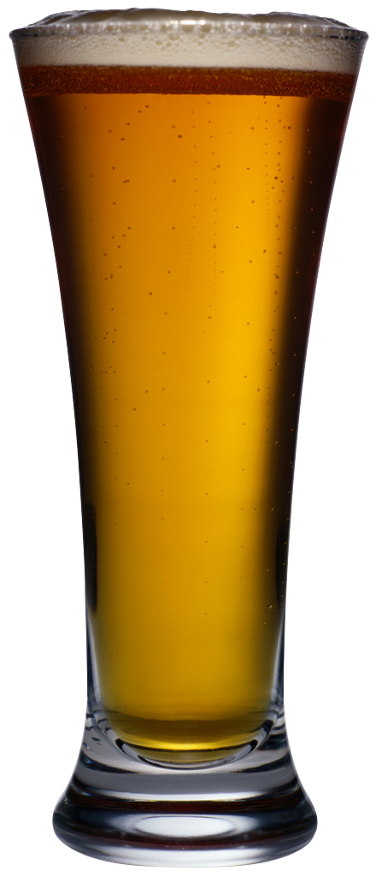
Notes:
But! He is also lazy. He wants to finish his job as fast as possible. What are the implications?

Slide 51
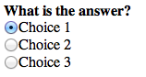

Slide 52
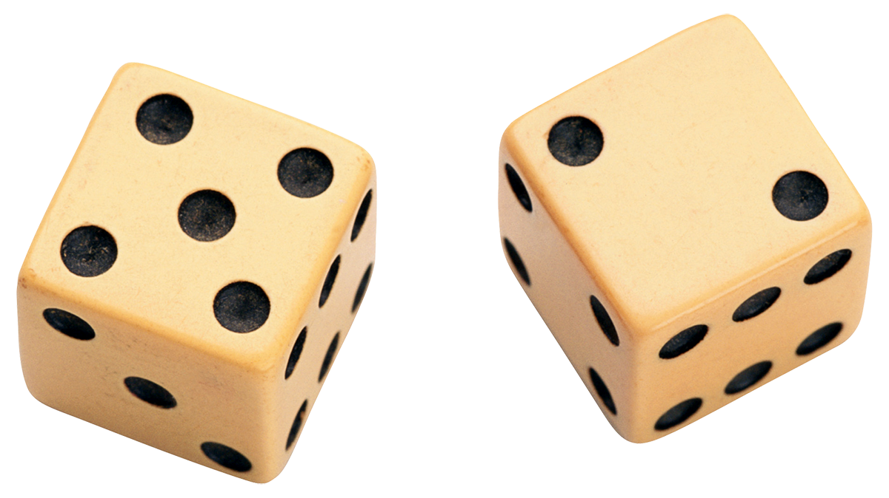

Slide 53
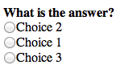
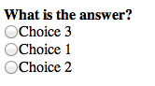

Slide 55
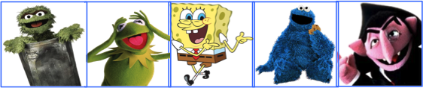
Which one of these doesn’t belong? [95% conf.]
Notes:
Here’s a toy example execution. Very hard to do by computer. Let’s just ask people.

Slide 56
Which one of these doesn’t belong? [95% conf.]
AutoMan: spawns 3 tasks @ $0.06; 30s work
t₁
t₂
t₃

Slide 57

Which one of these doesn’t belong? [95% conf.]
AutoMan: spawns 3 tasks @ $0.06; 30s work
t₁
t₂
t₃
1m 50s

Slide 58
Which one of these doesn’t belong? [95% conf.]
AutoMan: spawns 3 tasks @ $0.06; 30s work
t₁
t₂
t₃
1m 50s
2m 30s

Slide 59

Which one of these doesn’t belong? [95% conf.]
AutoMan: spawns 3 tasks @ $0.06; 30s work
t₁
t₂
t₃
1m 50s
2m 30s
2m 50s

Slide 60
Which one of these doesn’t belong? [95% conf.]
AutoMan: spawns 3 tasks @ $0.06; 30s work
t₁
t₂
t₃
1m 50s
2m 30s
Inconclusive!
2m 50s

Slide 61
Which one of these doesn’t belong? [95% conf.]
AutoMan: spawns 3 more tasks
t₁
t₂
t₃
t₄
t₅
t₆

Slide 62
Which one of these doesn’t belong? [95% conf.]
AutoMan: spawns 3 more tasks
t₁
t₂
t₃
t₄
t₅
t₆
7m

Slide 63
Which one of these doesn’t belong? [95% conf.]
AutoMan: spawns 3 more tasks
t₁
t₂
t₃
t₄
t₅
t₆
7m
18m 50s

Slide 64
Which one of these doesn’t belong? [95% conf.]
AutoMan: spawns 3 more tasks
t₁
t₂
t₃
t₄
t₅
t₆
7m
18m 50s
51m

Slide 65
Which one of these doesn’t belong? [95% conf.]
AutoMan: spawn 1 more task @ $0.12, 60s work
t₁
t₂
t₃
t₄
t₅
t₆
t₇

Slide 66
Which one of these doesn’t belong? [95% conf.]
AutoMan: spawn 1 more task @ $0.12, 60s work
t₁
t₂
t₃
t₄
t₅
t₆
t₇
1h 9m 50s;
cost = $0.36
AutoMan: 5 out of 6 ⇒ 95% confidence;
return

Slide 67
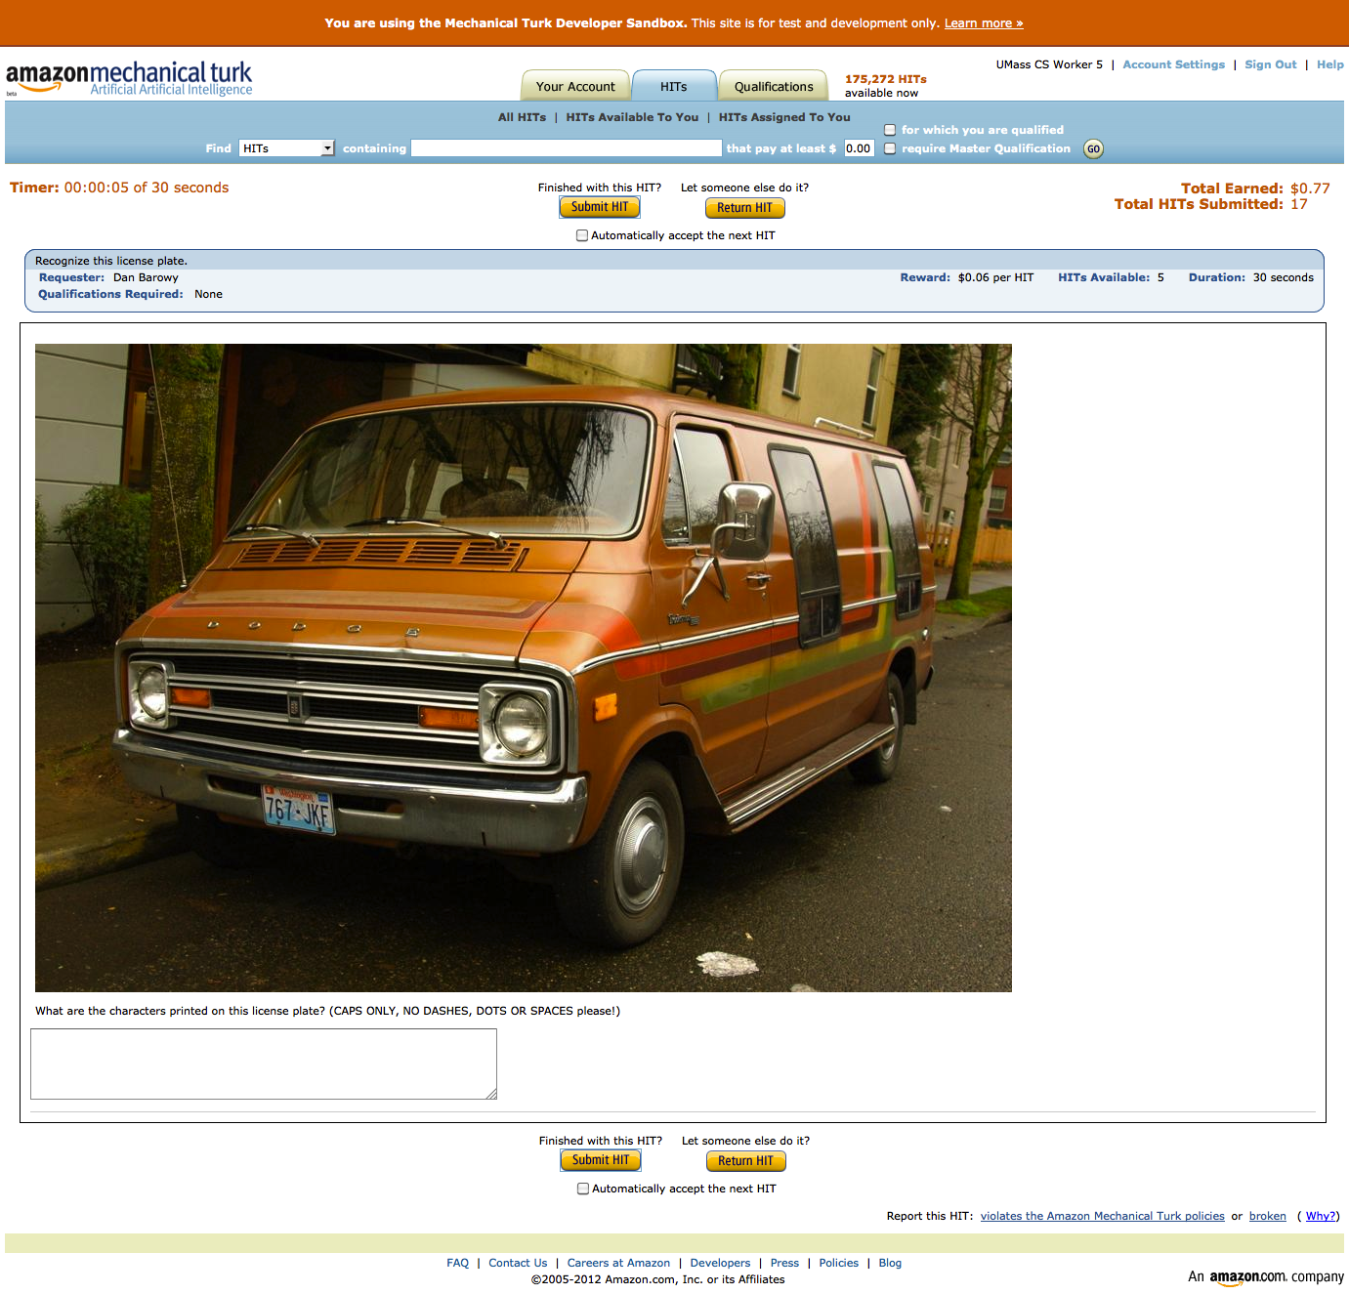

Slide 68
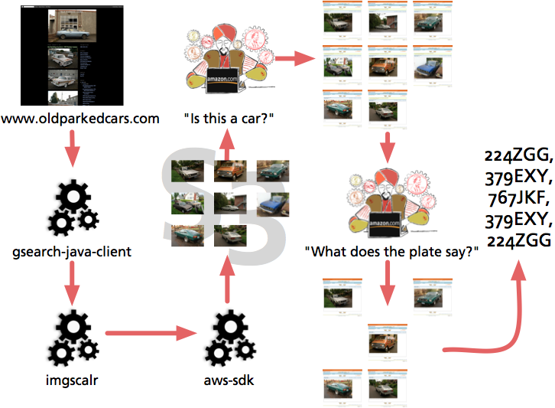

Slide 69
def is_readable_plate(image_url: String) = {
a.Task[String] { t =>
t.question = a.MultipleChoiceQuestion (
question_text = "Does this image PRIMARILY SHOW a vehicle with a CLEARLY READABLE license number plate?",
selection_texts = Map('yes -> "Yes.", 'no -> "No."))
t.question.image_url = image_url
}
}

Slide 70
def get_plate_text(image_url: String) = {
a.Task[String] { t =>
t.confidence = 0.90
t.title = "Recognize this license plate.”
t.question =
a.FreeTextQuestion("What are the characters printed on this license plate? (CAPS ONLY, NO DASHES, DOTS OR SPACES please!)")
t.question.num_choices = BigInt(36).pow(6)
// [A-Z0-9]
t.question.image_url = image_url
}
}

Slide 71
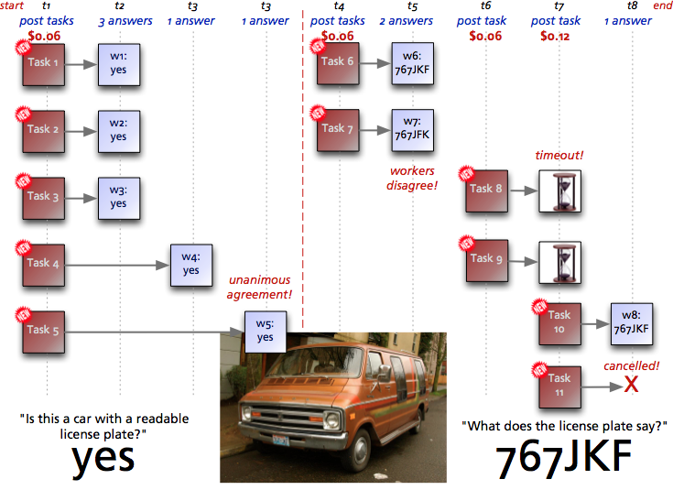

Slide 72
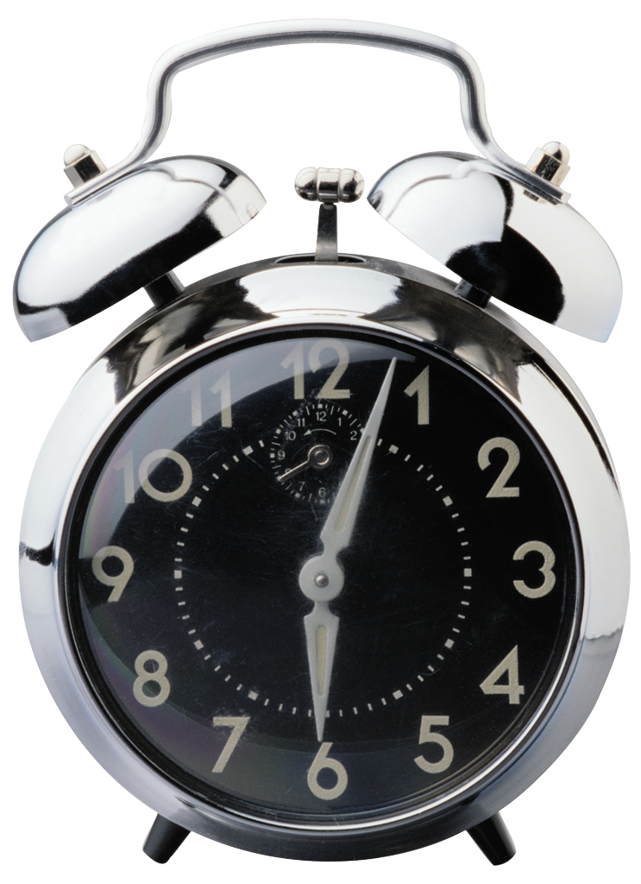
Notes:
Weird optimization opportunities. We think of optimizations as reducing time. How can we do that here?

Slide 73
=

Slide 74
=
Worker time = $7.25/hr

Slide 75

=
Worker time = $7.25/hr
Your time = $200/hr

Slide 76
=
Worker time = $7.25/hr
Your time = $200/hr
➔

Slide 77
=
Worker time = $7.25/hr
Your time = $200/hr
➔
Speculative Execution

Slide 78
Coming Attractions
General question answering (e.g. translation tasks)
Java / Web service API
Optimizations (time and $)

Slide 79
www.automan-lang.org

Slide 80


Slide 81
Coming Attractions
General question answering (e.g. translation tasks)
Java / Web service API
Optimizations (time and $)

Slide 82
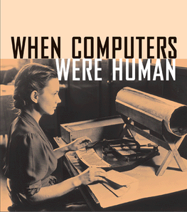

Slide 83
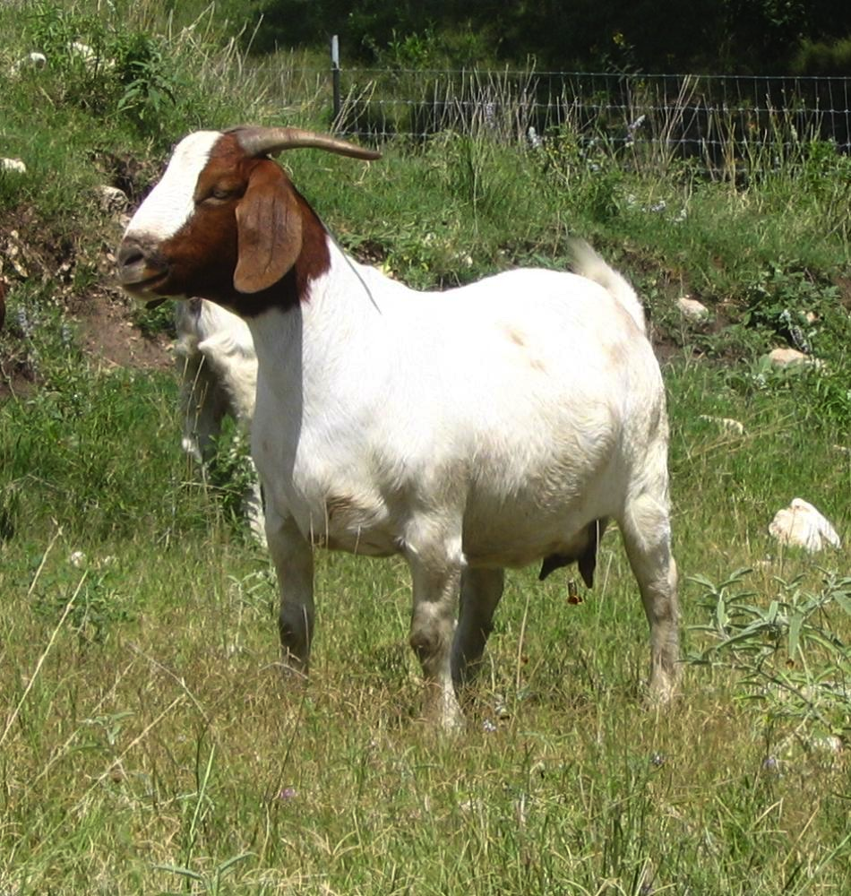
How many goats?

